Slide 1
AdviseMe
Advising made easy

Slide 2
Project Definition
Why - Many students have difficulty graduating on time due to a lack of guidance on what classes to take.
What - A desktop application that generates a recommended schedule.
How - This application will be written in python. (e.g. import advisor \n advisor.advise() )
Notes:
Timothy

Slide 3
Project Requirements
Functional
View courses student should take next semester (Advising)
View courses that can be transferred to/from current/transferring institution
Choose classes based on parameters set by user (e.g. course category, subject, etc.)
Message human advisor
Usability
Performance:
Efficient DB Querying; Efficient searching, sorting
User interface:
Performance - Efficient DB Querying; efficient searching
User interface - Subsystems connected through main GUI
System -
Software - Downloaded application
Database - Pandas, SQL
Security - Login ; Secure DB access
Notes:
Howie

Slide 4
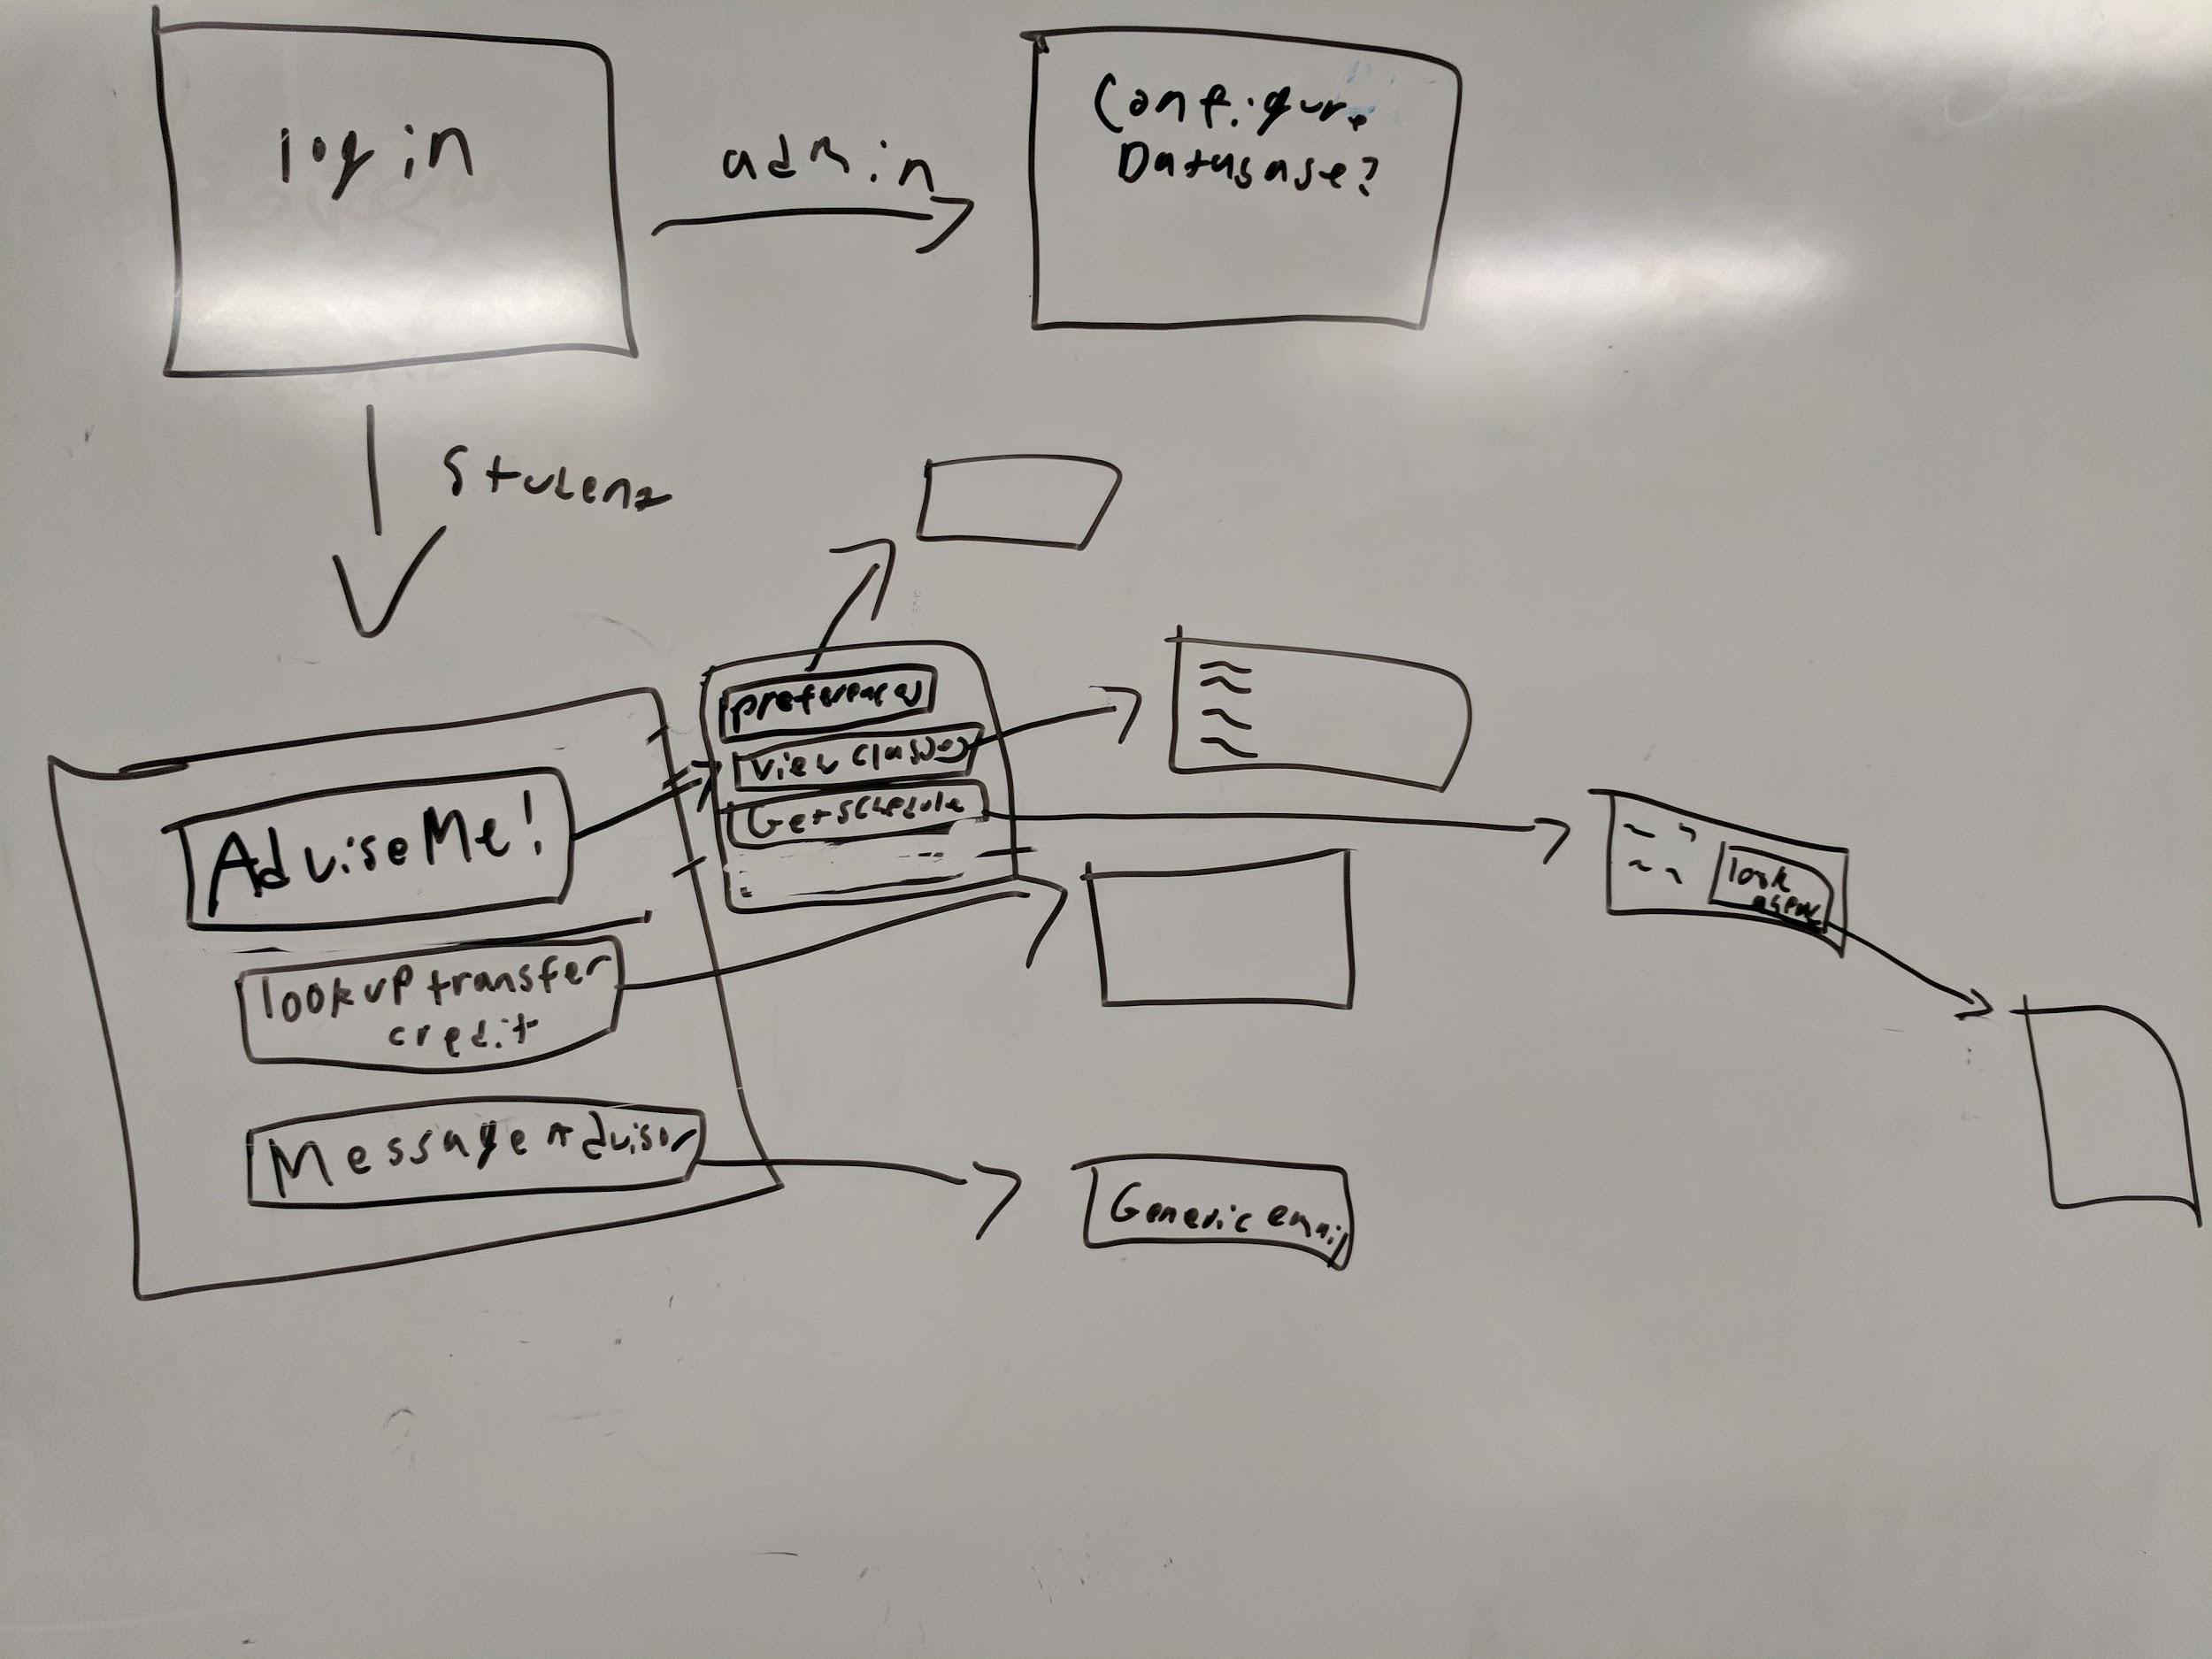
Project Specifications
Focus: Academic advising
Libraries: Github; Pandas; IDLE; Slack;
Platform : Desktop GUI ;
Genre: Academic
Notes:
Philip

Slide 5
Project Subsystems
Login - Gets user information, which includes major and completed classes/requirements.
Recommendations - Generates a list of potential classes based on students current progress in major. Prioritizes classes meeting multiple requirements.
Schedule - Generates schedule by date and time using recommended classes. Allows student to set preferences like time, subject, course categories.
Transfer - Determines what classes offered by one’s current institution would be accepted by another.
Notes:
Trevor

